Slide 1
Part A: context
1: The Agile Manifesto
2: Agile methods
3: Official agile principles
4: Agile values

Slide 2
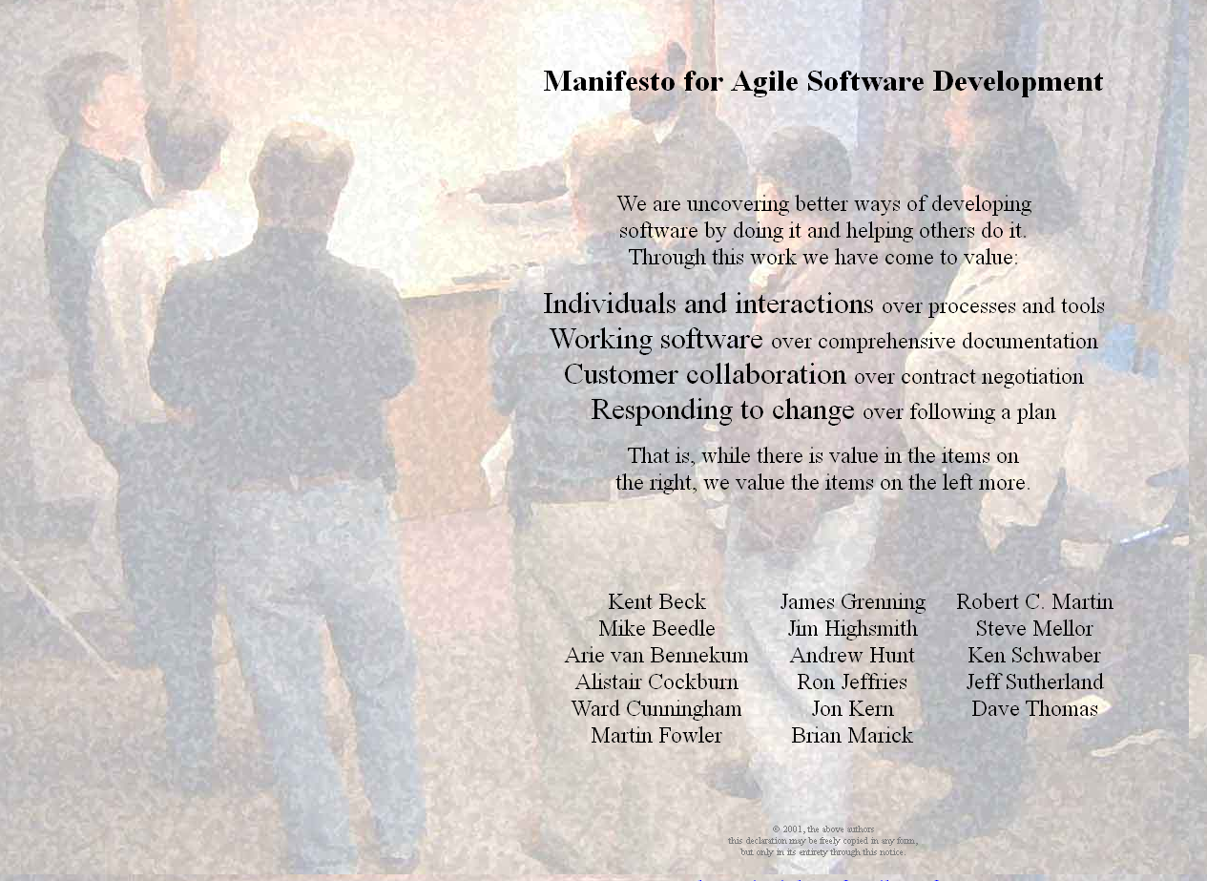
Agile manifesto
.
agilemanifesto.org
© the authors

Slide 3
Twelve principles (from the Manifesto)
Our highest priority is to satisfy the customer through early and continuous delivery of valuable software.
Welcome changing requirements, even late in development. Agile processes harness change for the customer's competitive advantage.
Deliver working software frequently, from a couple of weeks to a couple of months, with a preference to the shorter timescale.
Business people and developers must work together daily throughout the project.
Build projects around motivated individuals. Give them the environment and support they need, and trust them to get the job done.
The most efficient and effective method of conveying information to and within a development team is face-to-face conversation.
Working software is the primary measure of progress.
Agile processes promote sustainable development. The sponsors, developers, and users should be able to maintain a constant pace indefinitely.
Continuous attention to technical excellence and good design enhances agility.
Simplicity— the art of maximizing the amount of work not done —is essential.
The best architectures, requirements, and designs emerge from self-organizing teams.
At regular intervals, the team reflects on how to become more effective, then tunes and adjusts its behavior accordingly.

Slide 4
Part A: Context 1: The Agile Manifesto
What we have seen: A set of principles, defining Agile as seen by its creators

Slide 5
Supporting textbook
Agile! The Good, the Hype and the Ugly
Bertrand Meyer Springer, 2014

Slide 6
Part A: context
1: The Agile manifesto
2: Agile methods
3: Official agile principles
4: Agile values

Slide 7
Agile methods
XP
(Extreme programming) Kent Beck
Lean
Mary Poppendieck
Crystal
Alistair Cockburn
Scrum
Schwaber & Sutherland

Slide 8


XP: The revolt of the cubicles
.

Slide 9
Negotiated scope contract
XP
Source: Beck 05
“Write contracts for software development that fix time, costs, and quality but call for an ongoing negotiation of the precise scope of the system. Reduce risk by signing a sequence of short contracts instead of one long one.”
“You can move in the direction of negotiated scope. Big, long contracts can be split in half or thirds, with the optional part to be exercised only if both parties agree. Contracts with high costs for change requests can be written with less scope fixed up front and lower costs for changes”

Slide 10
Part A: Context 2: Agile methods
What we have seen: A number of agile methods have emerged They share the basics but differ in their goals and emphases

Slide 11
Part A: context
1: The Agile manifesto
2: Agile methods
3: Official agile principles
4: Agile values

Slide 12
Twelve principles
Source: Agile manifesto
Our highest priority is to satisfy the customer through early and continuous delivery of valuable software.
Welcome changing requirements, even late in development. Agile processes harness change for the customer's competitive advantage.
Deliver working software frequently, from a couple of weeks to a couple of months, with a preference to the shorter timescale.
Business people and developers must work together daily throughout the project.
Build projects around motivated individuals. Give them the environment and support they need, and trust them to get the job done.
The most efficient and effective method of conveying information to and within a development team is face-to-face conversation.
Working software is the primary measure of progress.
Agile processes promote sustainable development. The sponsors, developers, and users should be able to maintain a constant pace indefinitely.
Continuous attention to technical excellence and good design enhances agility.
Simplicity — the art of maximizing the amount of work not done — is essential.
The best architectures, requirements, and designs emerge from self-organizing teams.
At regular intervals, the team reflects on how to become more effective, then tunes and adjusts its behavior accordingly.
Redundancy
Practice
What about testing?
Redundancy
Assertion
Assertion
Assertion
Wrong
Practice

Slide 13
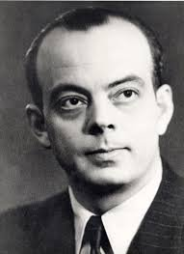
Finishing a design
It seems that the sole purpose of the work of engineers,
designers, and calculators is to polish and smooth out,
lighten this seam, balance that wing until it is no longer
noticed, until it is no longer a wing attached to a fuselage, but a form fully unfolded, finally freed from the ore, a sort of mysteriously joined whole, and of the same quality as that of a poem. It seems that perfection is reached, not when there is nothing more to add, but when there is no longer anything to remove.
(Antoine de Saint-Exupéry, Terre des Hommes, 1937)

Slide 14

Steve Jobs, 1998
That's been one of my mantras — focus and simplicity. Simple can be harder than complex: You have to work hard to get your thinking clean to make it simple. But it's worth it in the end because once you get there, you can move mountains.

Slide 15
Part A: Context 3: Official agile principles
What we have seen: The official principles give us a good starting point for understanding Agile, but they fall short of explaining exactly what the method is

Slide 16
Part A: context
1: The Agile manifesto
2: Agile methods
3: Official agile principles
4: Agile values

Slide 17
A more precise description
Agile values
Agile principles
Managerial
Technical
Agile roles
Agile practices
Managerial
Technical
Agile artifacts

Slide 18
Agile values
A New, reduced role for manager
B No “Big Upfront” steps
C Iterative development
D Limited, negotiated scope
E Focus on quality, achieved through testing

Slide 19
Part A: Context 4: Agile values
What we have seen: Beyond specific principles, practices and artifacts, Agile is defined by general values, representing a vision of how development should proceed

